Slide 1
SMART CRADLE
Under the guidance of:
Sudheer T M
Group members :
Adisha P V
Amithlal M V
Mohammed Arif P
Mohammed Ameer K T

Slide 2
Contents
Introduction
Motivation
Objective
Proposed Method
Components
Work done so far
References

Slide 3
Introduction
Cradle is a device that is used to put babies to sleep. Cradle has a side-to-side rocking motion that eases the baby and put it to sleep.Managing the work in time of parents and taking care of baby is very important factors . This automatic cradle system will make parents stress free and will give parents required time to rest .
In the proposed design, there will be a circuit placed along the cradle which will sense the crying sound of the child and swings the cradle automatically and produces a music and sound which provides the child a good environment to sleep.
Inorder to control the cradle and its speed the system is connected to a mobile phone application.
Switches will be provided on the cradle for different controls like manual mode,automatic mode,swing control etc.

Slide 4
Motivation
Parents in the present world are busy in their professional life, so they do not get sufficient time to take care of their babies. It is inconvenient for parents to constantly watch over their baby while doing their work or chores.It is impossible for a parent to give 100% attention to the infant.It takes lot of efforts from parent to physically rock the cradle to generate swinging motion.Now a days, even the mothers are working and there is a requirement of unattended cradle .

Slide 5
Objective
A system capable of soothing and monitoing the baby itself.
Reducing stress for parents and gives them proper time to rest.
Automatic cradle swing andmusic system.
Gives alert to parents through mobile application.
It is affordable and easy to use.

Slide 6
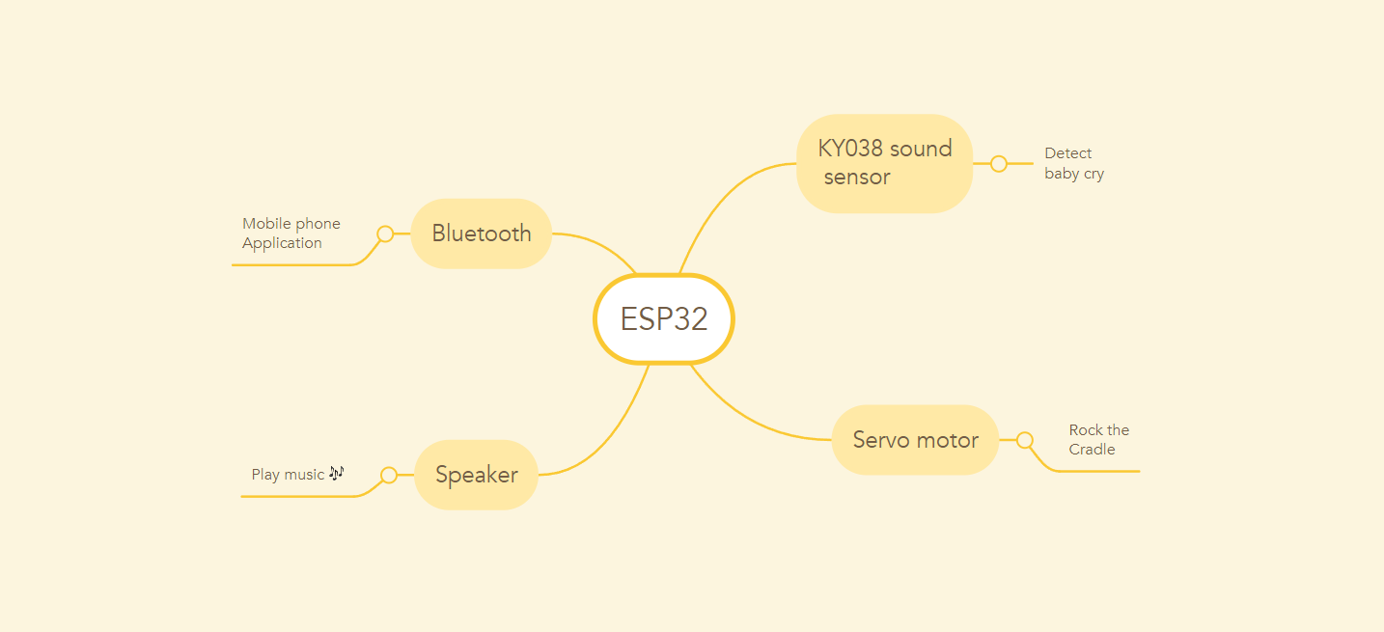
Proposed Method Block Diagram

Slide 7
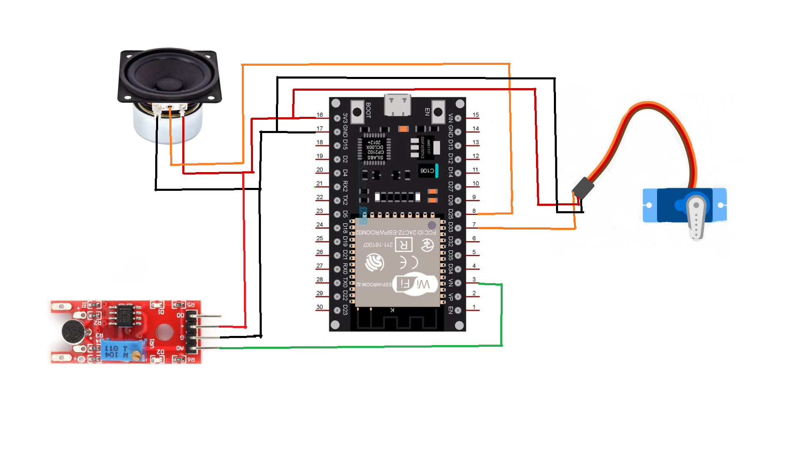
Circuit design

Slide 8
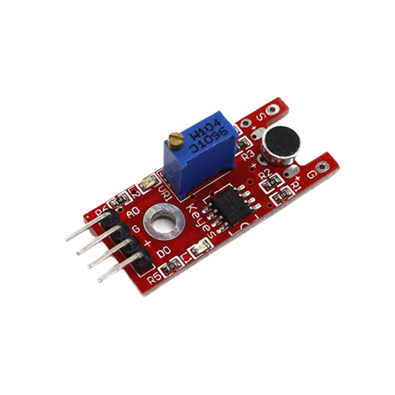
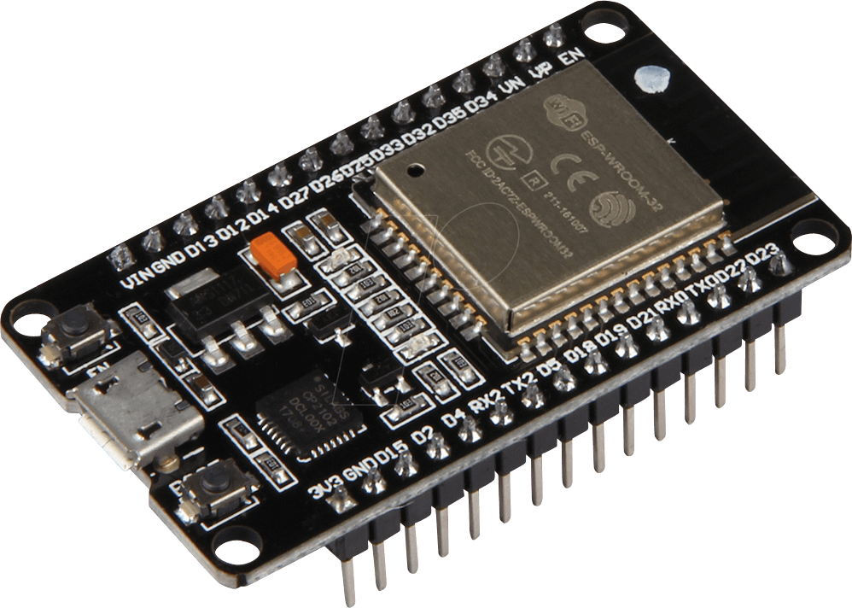
Components
Hardware Components
ESP-WROOM-32
KY-038 Sound Sensor

Slide 9
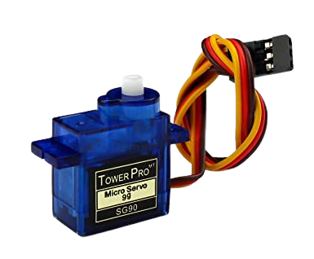
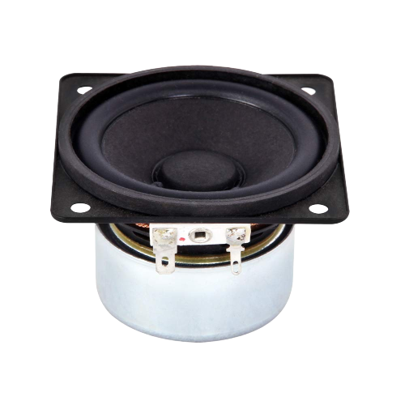
Servo Motor
Speaker

Slide 10
Softwares used
Arduino ide
MIT app inventor
Audacity

Slide 11
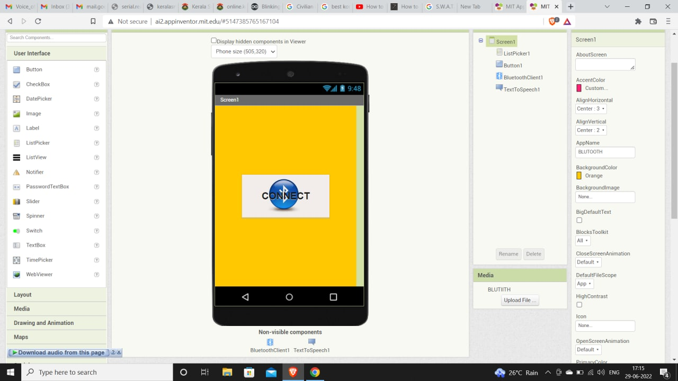
Work done so far Software : mobile phone app created

Slide 12
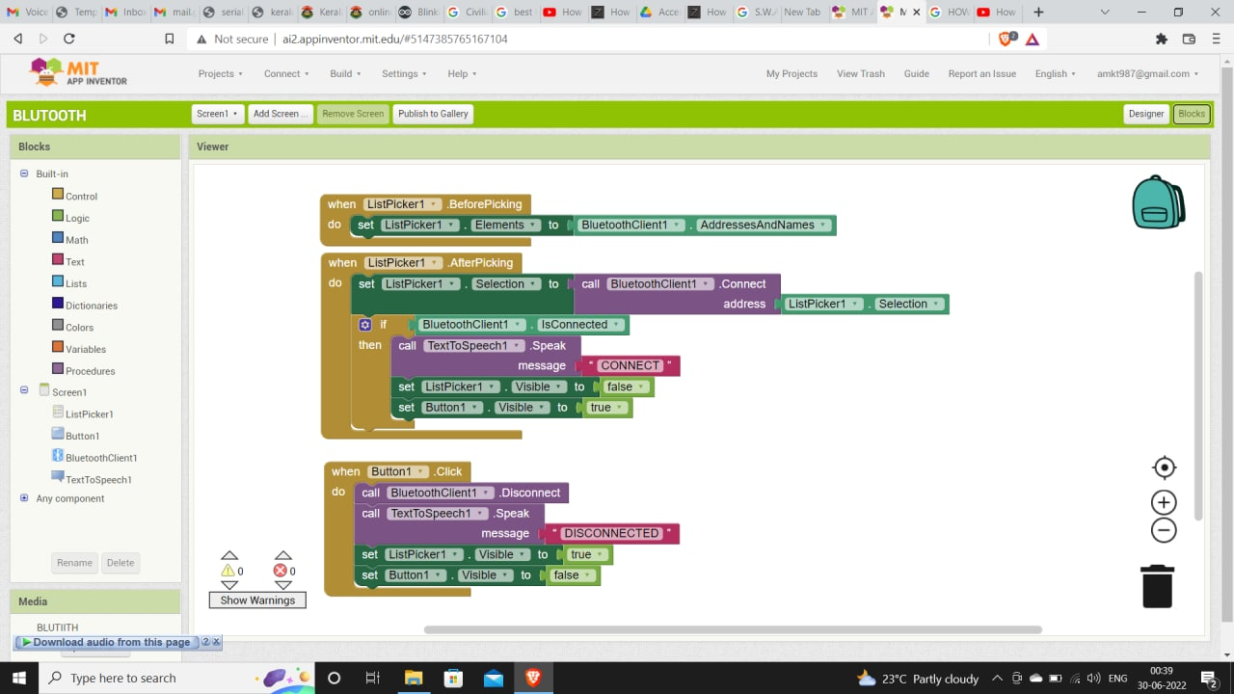
Application backend

Slide 13
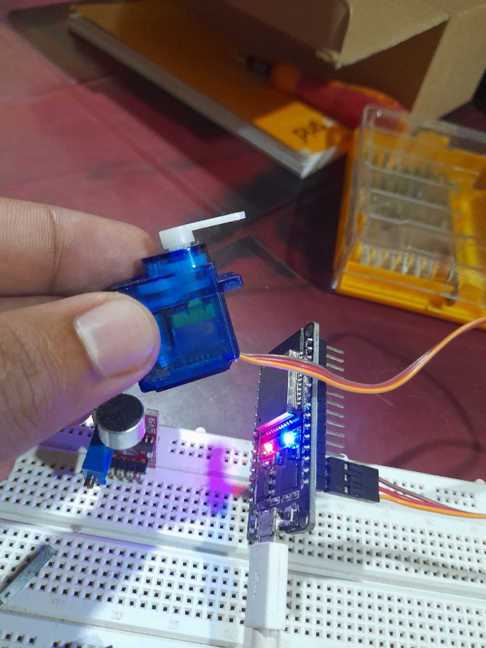
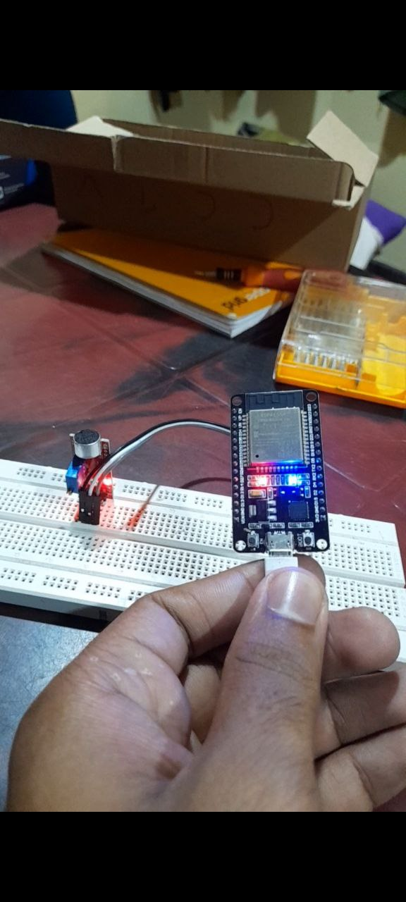
Hardware Sensors are tested interfacing with esp32 Circuit Layout on progress.

Slide 14
References
https://www.irjet.net/
https://www.researchgate.net/
https://www.youtube.com/watch?v=-vfB3ZONkJo&list=PL0guVS28dktIl3h7Snv2VmWEPgfEzSUTe&index=7&t=166s
https://www.youtube.com/watch?v=aQcJ4uHdQEA
https://learnmech.com/

Slide 15
Thank You

